Slide 1

Fundamentals of AI in Manufacturing (FAIM) Genetic Algorithms Lecturers: Abhilash Puthanveettil Madathil, PhD Olga Bylya, PhD Applied Industrial Intelligence (AI²) NMIS

Slide 2
Contents
Introduction to evolutionary optimization algorithms
Introduction to Genetic Algorithm
GA practice problems

Slide 3
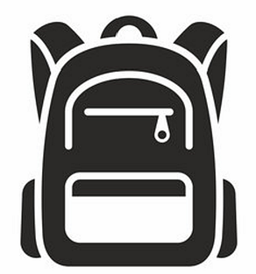
Knapsack problem
Select items with given weights and values to include in a "knapsack" (container) with a maximum weight capacity, aiming to maximize the total value of the chosen items without exceeding the weight limit
If we have only 5 items, it might be possible to do all combinations and get the optimal solution.
What if we have 20/30/70 items? What is the limit?
Solution: Population based meta heuristic algorithms
Item | Weight | Value
1 | 2 kg | £3
2 | 3 kg | £4
3 | 4 kg | £8
4 | 5 kg | £8
5 | 9 kg | £10
1
2
3
4
10 kg
5

Slide 4
Metaheuristic optimization methods
Algorithms that iteratively search for near-optimal solutions to a problem by maintaining and evolving a set of candidate solutions, called a population
Evolutionary Algorithms
Inspiration: Darwinian evolution — survival of the fittest.
Swarm intelligence
A form of collective learning and decision-making inspired by the collective behavior of organisms in nature

Slide 5
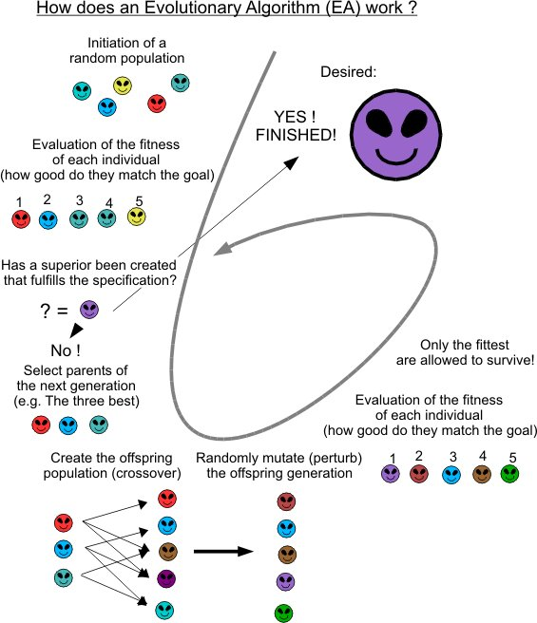
Evolutionary Algorithms

Slide 6
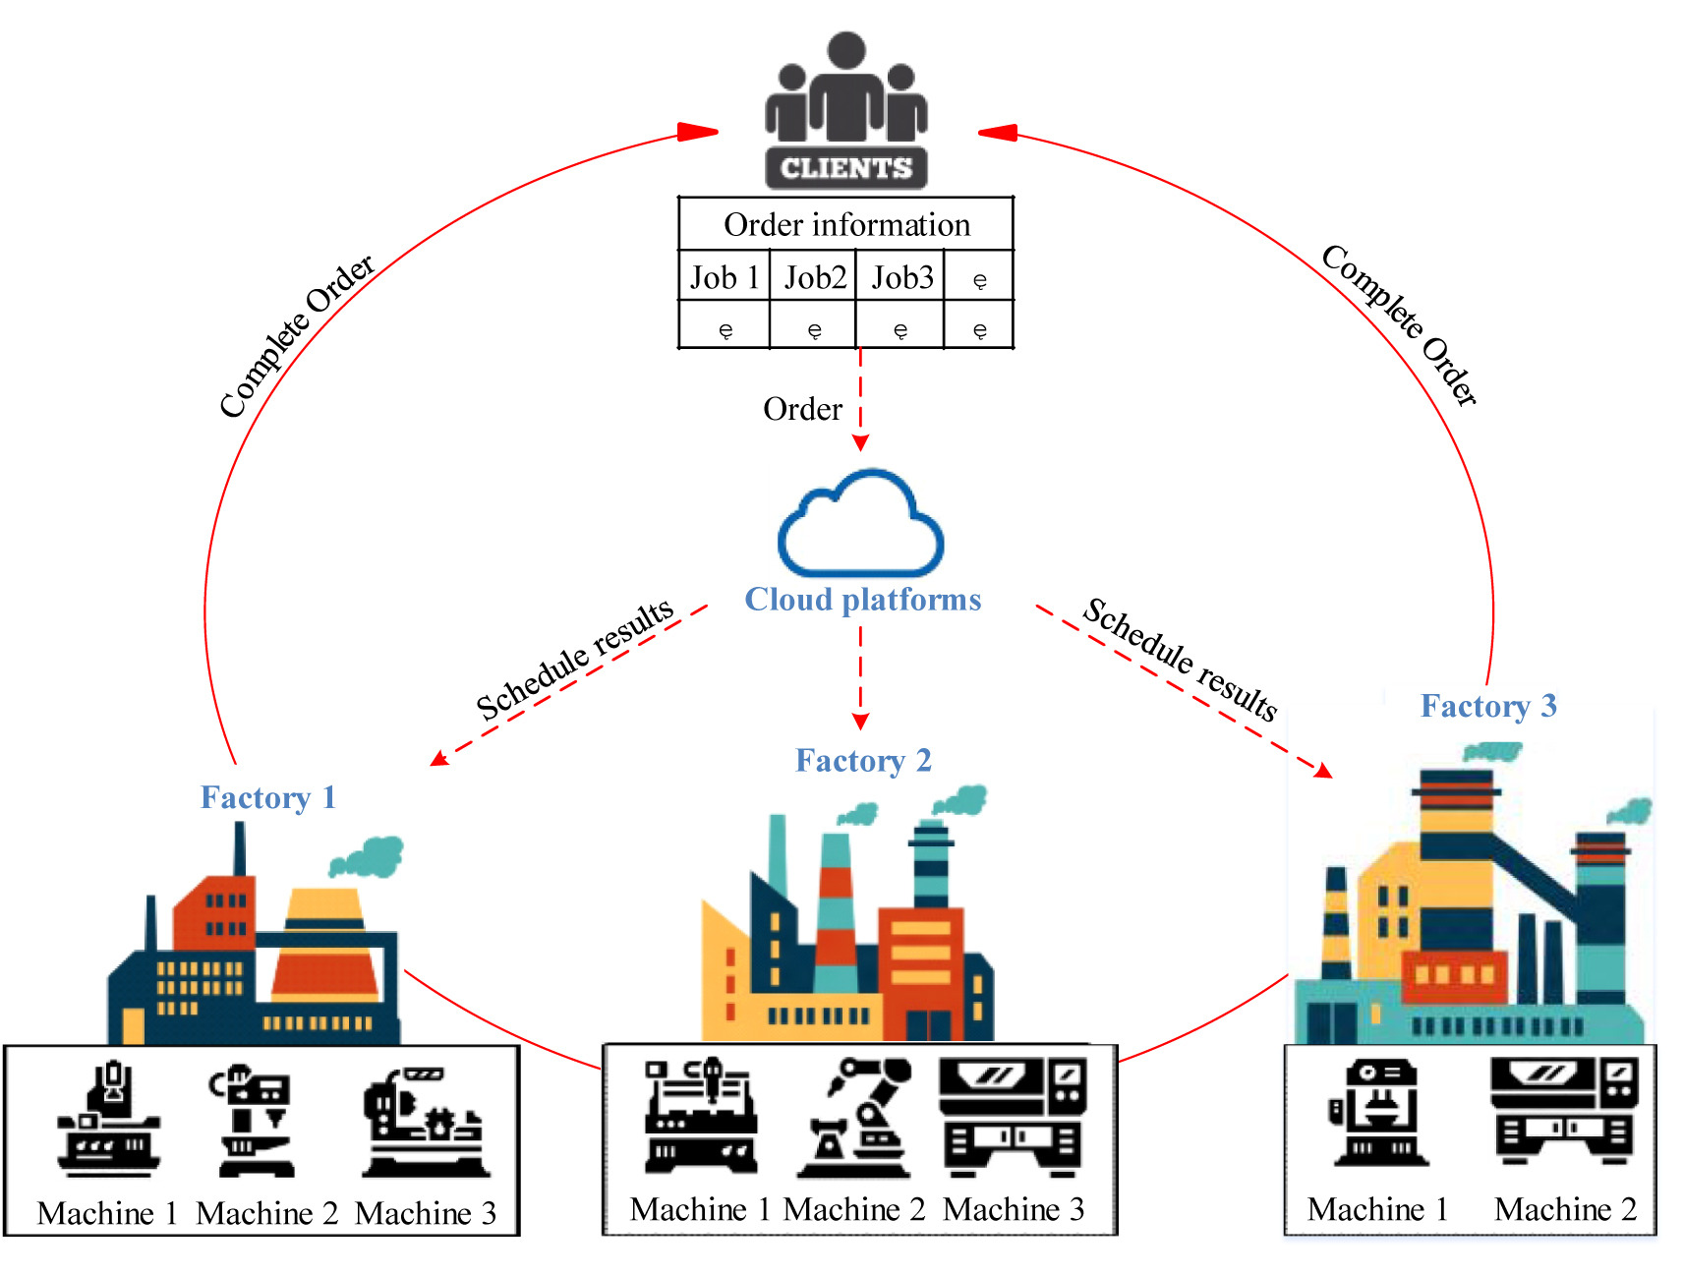
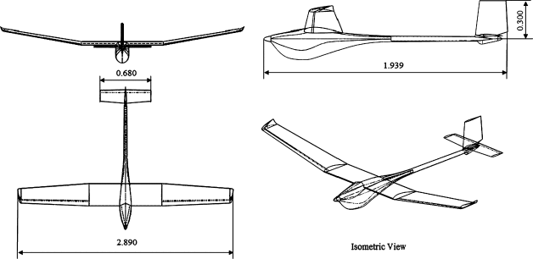
Genetic Algorithms
A Genetic Algorithm is a subclass of evolutionary algorithms that uses biologically inspired natural selection to evolve approximate solutions to optimization and search problems, guided by a fitness function that evaluates solution quality
Applications in AI modelling context
Train ANNs ¹
Optimize architecture of ANNs ²
Industrial Applications
Design optimization
Job scheduling
Facility layout planning
Tool path optimization
Process parameter optimization
UAV aerodynamic design involving genetic algorithm
Boutemedjet, et al. (2019). Aerospace Science and Technology, 84, 464-483.
1. Gupta, J. N., & Sexton, R. S. (1999). Comparing backpropagation with a genetic algorithm for neural network training. Omega, 27(6), 679-684.
2. Real, E., Aggarwal, A., Huang, Y., & Le, Q. V. (2018). Regularized evolutionfor image classifier architecture search. CoRR, vol. abs/1802, 1548.

Slide 7
Gradient Descent
Genetic Algorithm
Gradient descent requires the objective function to be differentiable and computes gradients to navigate the search space, making it efficient for smooth and convex functions but less effective in complex or discontinuous landscapes
Genetic algorithms (GAs) do not require the objective function to be continuous or differentiable, as they do not rely on gradient information. Instead, GAs use mechanisms inspired by natural evolution—such as selection, crossover, mutation, and evaluation—to explore the search space and optimize the fitness function. This makes them suitable for complex, multimodal, or stochastic search spaces

Slide 8
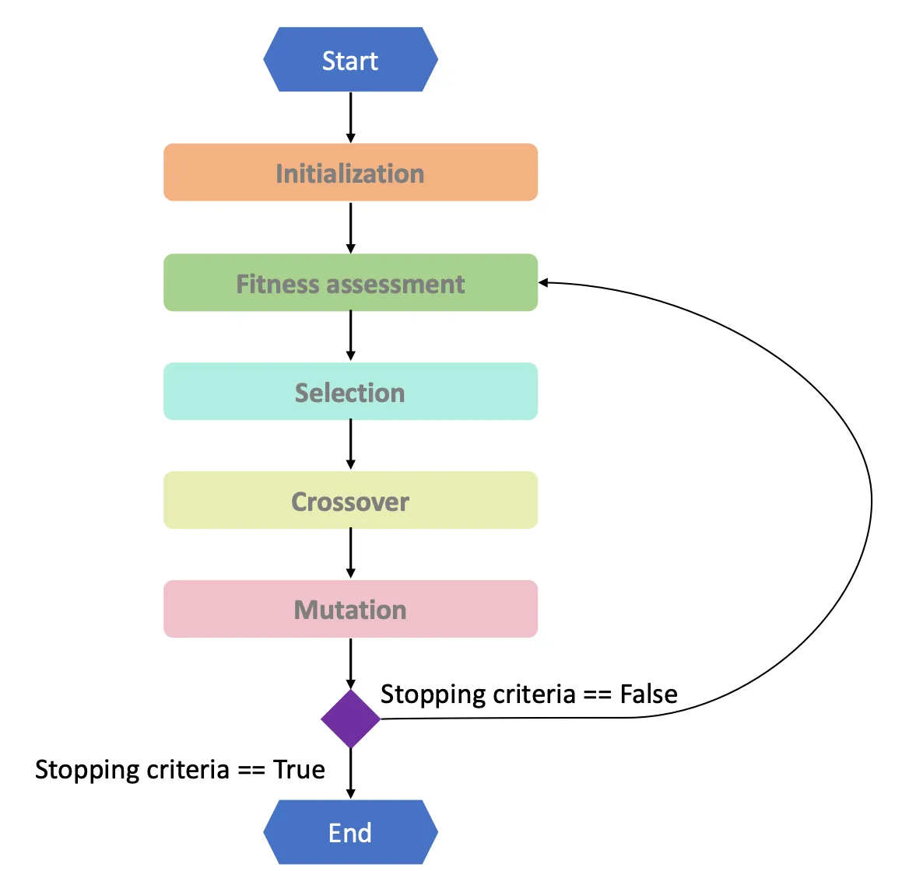
Genetic Algorithm
Initialization: A set of possible solutions (individuals).
Fitness Function: A way to evaluate how "good" a solution is.
Selection: The process of picking better solutions to reproduce.
Crossover (Recombination): Combining parts of two solutions to create new ones.
Mutation: Introducing random changes to solutions – preserves diversity, prevents being stuck at local minima.
Survival of the Fittest: Better solutions are more likely to survive and reproduce.

Slide 9
Knapsack problem
Select items with given weights and values to include in a "knapsack" (container) with a maximum weight capacity, aiming to maximize the total value of the chosen items without exceeding the weight limit
We have 5 items. Each item can be either included (1) or not (0) in the knapsack. The knapsack has a weight capacity of 10.
Goal: maximize total value without exceeding weight 10.
Item | Weight | Value
1 | 2 kg | £3
2 | 3 kg | £4
3 | 4 kg | £8
4 | 5 kg | £8
5 | 9 kg | £10
1
2
3
4
10 kg
5

Slide 10
Knapsack problem
Binary Encoding
Each individual is a 5-bit string [b₁ b₂ b₃ b₄ b₅], where b_{i} = 1 means we take item i.
Examples:
00100 → take only item 3
01010 → take items 2 and 4
00110 → take items 3 and 4
Item | Weight | Value
1 | 2 kg | £3
2 | 3 kg | £4
3 | 4 kg | £8
4 | 5 kg | £8
5 | 9 kg | £10
1
2
3
4
5
10 kg

Slide 11
Knapsack problem
GA hyperparameters
Population size: 6
Selection: tournament (size 2)
Crossover: 1-point crossover (cut after bit 2)
Mutation: bit-flip, probability
Replacement: generational (children replace parents)
Item | Weight | Value
1 | 2 kg | £3
2 | 3 kg | £4
3 | 4 kg | £8
4 | 5 kg | £8
5 | 9 kg | £10
1
2
3
4
5

Slide 12
Knapsack problem
Initial population (Generation 0)
ID | Bits | Items Chosen | Weight | Value | Fitness
A | 00100 | {3} | 4 | 8 | 8
B | 00010 | {4} | 5 | 8 | 8
C | 01010 | {2,4} | 3+5=8 | 4+8=12 | 12
D | 00101 | {3,5} | 4+9=13 | 8+10=18 | 0 (overweight)
E | 10010 | {1,4} | 2+5=7 | 3+8=11 | 11
F | 10100 | {1,3} | 2+4=6 | 3+8=11 | 11
Item | Weight | Value
1 | 2 kg | £3
2 | 3 kg | £4
3 | 4 kg | £8
4 | 5 kg | £8
5 | 9 kg | £10
1
2
Best in Gen 0: (fitness 12)
Average fitness: 8.33
3
4
5

Slide 13
Knapsack problem
Selection (tournament size 2)
Run 6 mini-tournaments (with replacement) to pick 6 parents, then pair them up for crossover.
C (12) vs D (0) → C
E (11) vs A (8) → E
B (8) vs F (11) → F
A (8) vs C (12) → C
B (8) vs E (11) → E
D (0) vs A (8) → A
Parents in order: [C, E, F, C, E, A]
We’ll pair them as (C,E), (F,C), (E,A) for crossover.
Item | Weight | Value
1 | 2 kg | £3
2 | 3 kg | £4
3 | 4 kg | £8
4 | 5 kg | £8
5 | 9 kg | £10
1
2
3
4
5

Slide 14
Knapsack problem
Crossover (1-point after bit 2)
Cut position: b1 b2 | b3 b4 b5
C = 01010 → left 01 | right 010
E = 10010 → left 10 | right 010
F = 10100 → left 10 | right 100
A = 00100 → left 00 | right 100
Pair 1: (C, E)
Child 1 = 01 + 010 = 01010
Child 2 = 10 + 010 = 10010
Pair 2: (F, C)
Child 3 = 10 + 010 = 10010
Child 4 = 01 + 100 = 01100
Pair 3: (E, A)
Child 5 = 10 + 100 = 10100
Child 6 = 00 + 010 = 00010
Children: [01010, 10010, 10010, 01100, 10100, 00010]
Generational GA (new children replaces old population)

Slide 15
Knapsack problem
Mutation (bit-flip)
Let’s say one bit mutation happens (for illustration) on Child 6 at bit 3 (flip 0→1):
Child 6: 00010 → 00110
Children after mutation: [01010, 10010, 10010, 01100, 10100, 00110]
Item | Weight | Value
1 | 2 kg | £3
2 | 3 kg | £4
3 | 4 kg | £8
4 | 5 kg | £8
5 | 9 kg | £10
1
2
3
4
5

Slide 16
Knapsack problem
Generation 1
Child | Bits | Items Chosen | Weight | Value | Fitness
1 | 01010 | {2,4} | 3+5=8 | 4+8=12 | 12
2 | 10010 | {1,4} | 2+5=7 | 3+8=11 | 11
3 | 10010 | {1,4} | 2+5=7 | 3+8=11 | 11
4 | 01100 | {2,3} | 3+4=7 | 4+8=12 | 12
5 | 10100 | {1,3} | 2+4=6 | 3+8=11 | 11
6 | 00110 | {3,4} | 4+5=9 | 8+8=16 | 16
Best in Gen 1: (fitness 16)
Average fitness: 12.16 (an improvement from 8.33)

Slide 17


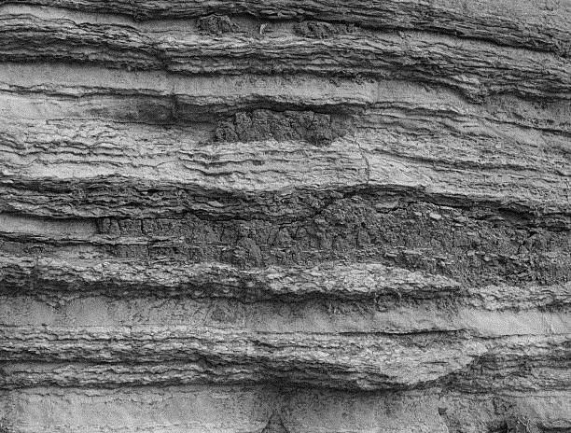


Tresure hunt
Imagine you're a treasure hunter on a grand adventure! You've got a mysterious map that shows a treasure buried underground, but there's a twist! The map doesn’t show the exact location of the treasure, but it does give you a clue - a special formula to follow y = x².
This formula tells you how deep you can dig, if you dig at different spots along the ground. But here's the deal: the treasure is hidden at the lowest point, where the ground dips down the most—the deepest spot (the minimum value of y)!
You can explore the land between x = -10 and x = 10, but somewhere in between lies the sweet spot where the ground is the lowest, and that's where the treasure is waiting for you!
Your mission: figure out where to start digging to reach the deepest point and find the treasure!
x = -10
x = 10
y = x²

Slide 18
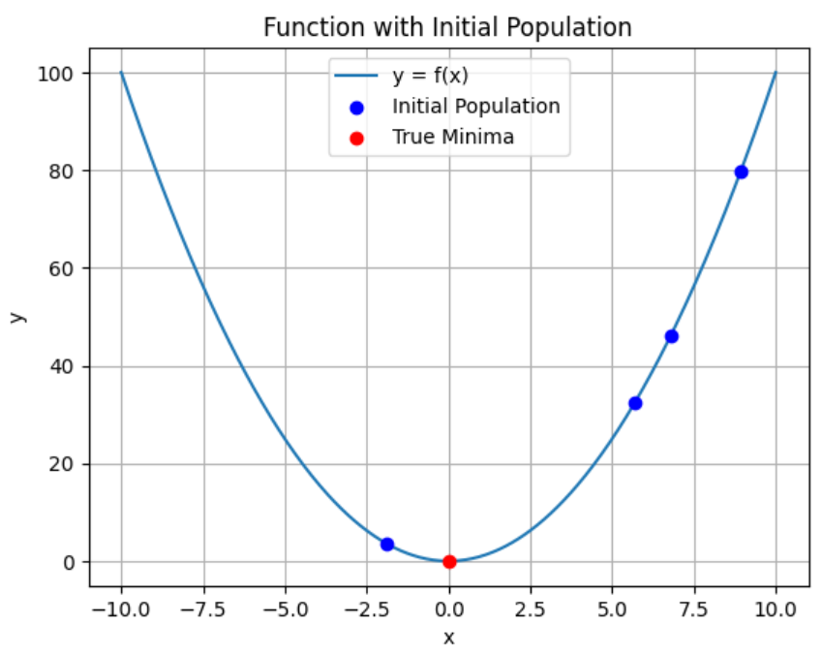
Minimize y = x² in the interval [-10, 10]
1. Initialization
We choose a population size, say N.
We generate N candidate solutions (often called “individuals” or “chromosomes”), each corresponding to a value of x.
In previous case x was encoded in binary, but here let’s consider real values directly.
Example
Let N = 4.
We randomly initialize 4 real-valued solutions xᵢ in the interval [−10, 10].
Suppose we get:
x₍₁₎ = 6, x₍₂₎ = -2.4, x₍₃₎ = 9, x₍₄₎ = 7.4.
So, our initial population
P₍₀₎ = {6, -2.4, 9, 7.4]

Slide 19
2. Evaluation (Fitness Assessment)
We compute the objective function f(x) for each candidate in the population.
Since we want to minimize f(x) = x², lower values of x² are “better.”
Example
Compute f(x) = x² for each individual:
f(x₁) = f (6) = 36
f(x₂) = f (-2.4) = 5.76
f(x₃) = f (9) = 81
f(x₄) = f (7.4) = 54.76
Ranking from best (lowest x²) to worst:
f(x₁) = f (-2.4) = 5.76
f(x₂) = f (6) = 36
f(x₃) = f (7.4) = 54.76
f(x₄) = f (9) = 81

Slide 20
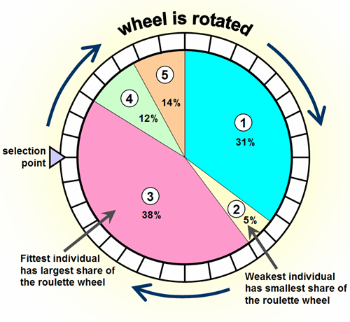
Alternate approach to ‘tournament selection’
Roulette wheel selection
3. Selection
We select which individuals will become “parents” to produce the next generation.
Many selection schemes exist (roulette wheel, tournament, etc.). The idea is that individuals with better (lower) f(x) values have a higher probability of being chosen.
Example
One simple approach is tournament selection:
Randomly pick two individuals from the population.
Compare their f(x) values.
Choose the one with the lower f(x) as a parent.
So, if we run tournament selection a few times, the best solutions (-2.4 and 6) will be picked more frequently as parents, while the worse ones (7.4 and 9) might still get selected occasionally, but with lower probability

Slide 21
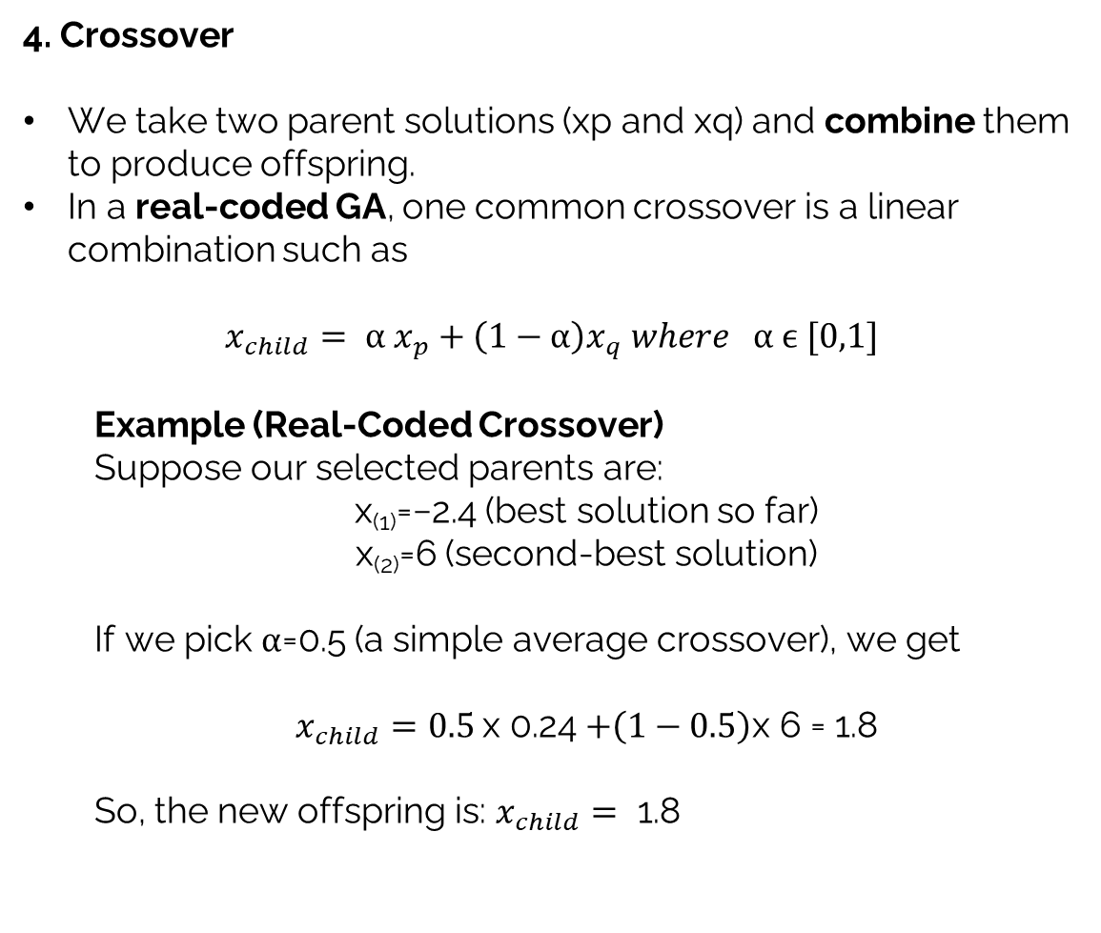
4. Crossover
We take two parent solutions (xp​ and xq​) and combine them to produce offspring.
In a real-coded GA, one common crossover is a linear combination such as
$$x_{child}= α x_{p}+\left(1−α\right)x_{q} where α ϵ [0,1]$$
Example (Real-Coded Crossover)
Suppose our selected parents are:
x₍₁₎=−2.4 (best solution so far)
x₍₂₎=6 (second-best solution)
If we pick α=0.5 (a simple average crossover), we get
$x_{child}=0.5$x 0.24 $+\left(1−0.5\right)\text{x}\text{ 6 = 1.8}$
So, the new offspring is: $x_{child}=\text{ 1.8}$

Slide 22
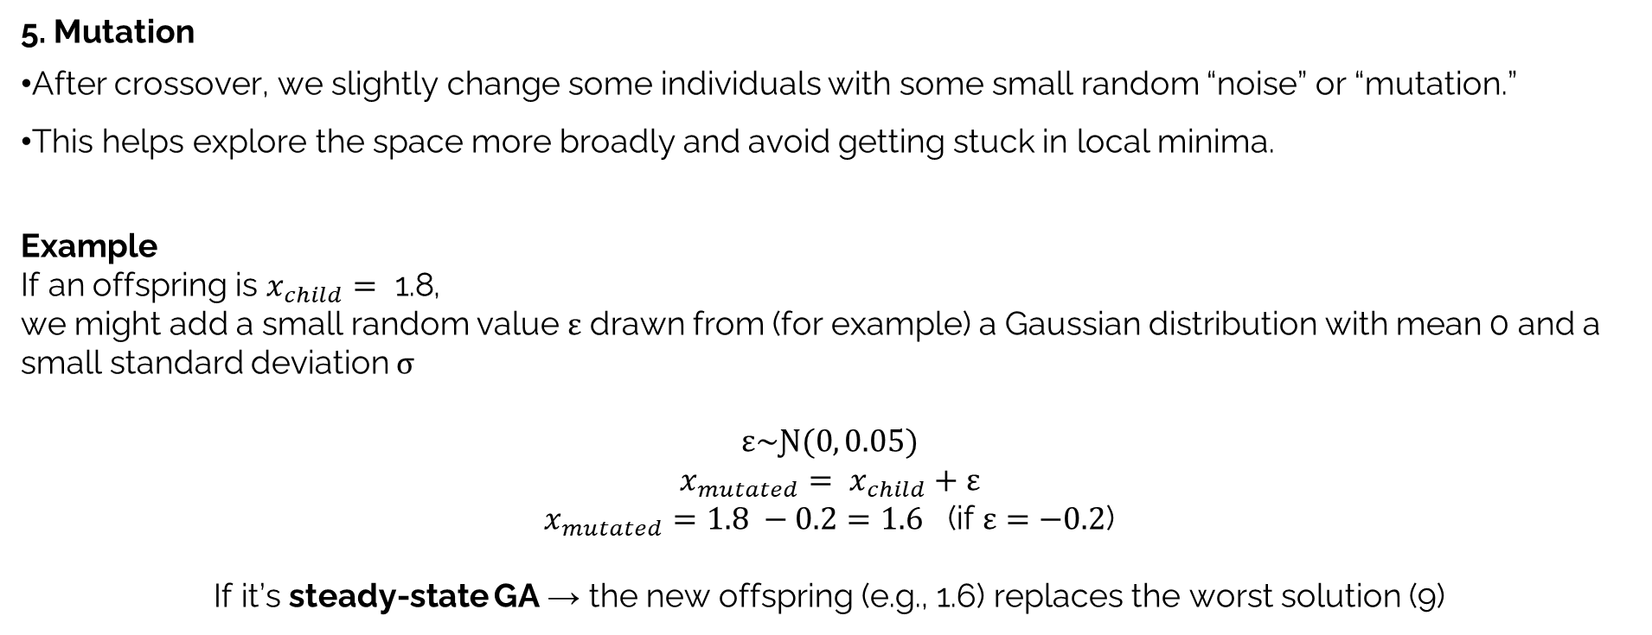
5. Mutation
After crossover, we slightly change some individuals with some small random “noise” or “mutation.”
This helps explore the space more broadly and avoid getting stuck in local minima.
Example
If an offspring is $x_{child}=\text{ 1.8}$,
we might add a small random value ε drawn from (for example) a Gaussian distribution with mean 0 and a small standard deviation σ
$$ε\sim Ɲ(0, 0.05)$$
$$x_{mutated}= x_{child}+ε$$
$x_{mutated}=1.8 −0.2=1.6$ (if $ε=−0.2$)
If it’s steady-state GA → the new offspring (e.g., 1.6) replaces the worst solution (9)
Generation 0
Generation 1
f(x₁) = f (-2.4) = 5.76
f(x₂) = f (6) = 36
f(x₃) = f (7.4) = 54.76
f(x₄) = f (9) = 81
f(x₁) = f (-2.4) = 5.76
f(x₂) = f (6) = 36
f(x₃) = f (7.4) = 54.76
f(x₄) = f (1.6) = 3.24

Slide 23
Generation 0
Generation 1
f(x₁) = f (-2.4) = 5.76
f(x₂) = f (6) = 36
f(x₃) = f (7.4) = 54.76
f(x₄) = f (9) = 81
f(x₁) = f (-2.4) = 5.76
f(x₂) = f (6) = 36
f(x₃) = f (7.4) = 54.76
f(x₄) = f (1.6) = 3.24

Slide 24
